Slide 1
Explaining Patterns of Malnutrition among Children in Uganda
Jing Hao
04/15/2013

Slide 2
Outline
Introduction
Data
Modeling child stunting and wasting
Results
Conclusions and further research

Slide 3
Introduction

Slide 4
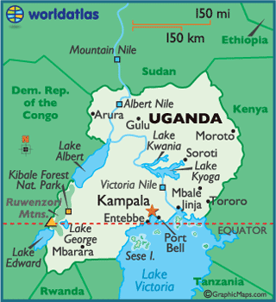
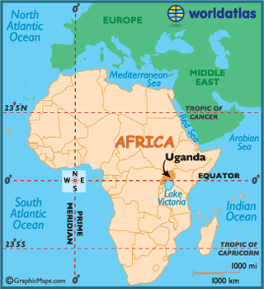
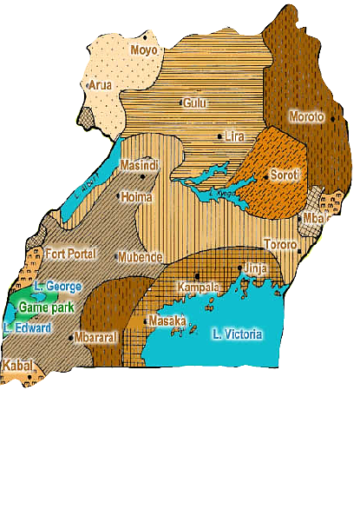
Source: http://www.turkey-visit.com/uganda-map.asp
FAO, 2006

Slide 5

Background
Child malnutrition is a severe problem in Uganda
Causes 40% of child deaths
Stunting rate: 38%
Wasting rate: 6%
Underweight rate: 16%
Low Agricultural productivity
Agricultural yields <1/3 potential yield
lack of usage of improved inputs
soil erosion
lack of irrigation facilities
over-dependence on rainfall
limited access to farm credit
Mothers’ education
Maternal health and breastfeeding
Regional differences
Clean water and improved sanitation

Slide 6
Research Questions
Which factors play the most important roles in improving child growth outcomes in Uganda?
Do differences in agricultural potential and productivity help to explain differences in rates of child malnutrition?

Slide 7
Data

Slide 8
Data Sources and Construction
2006 Uganda Demographic and Health Survey (UDHS)
Child characteristics
Mother characteristics
Father and household characteristics
2005/06 Uganda National Household Survey (UNHS)
Agricultural performance
Distance to nearest health facility
Normalized Difference Vegetation Index (NDVI)
Remotely sensed data at a 5 km spatial resolution
[-1, 1]
Jan 2001 - Dec 2011
Merged by nesting of district, urban/rural, sex of head of household and farm size
Merged by DHS cluster

Slide 9

Child Z-scores
Used as indicators of child nutritional status
$\text{Z}\text{i}=\frac{X_{i}−\overline{X}}{σ}$
HAZ
WAZ
WHZ
Note: Data for 2,176 Ugandan children below age five, from 2006 UDHS.
HAZ<-2 SD indicates stunting (chronic malnutrition)
WHZ<-2 SD indicates wasting (acute malnutrition)

Slide 10
Mother Characteristics
mother’s age
mother’s education
mother’s BMI
breastfeeding time

Slide 11
Household Characteristics
wealth index score
food expenditure share
dependency ratio
household income

Slide 12
NDVIs
NDVI-05-harvest
NDVI-06-harvest
NDVI-birth-harvest
NDVI-utero-harvest

Slide 13
Modeling of child stunting and wasting

Slide 14
OLS Approach
Z_{i}= α₁ + β_{1i}A_{i} +ε_{1j}
Z_{i}= α₂ + β_{2i}A_{i}+τ_{2i}B_{i} +ε_{2j}
Z_{i}= α₃ + β_{3i}A_{i}+τ_{3i}B_{i}+γ_{3i}C_{i}+ε_{3j}
Z_{i}= α₄ + β_{4i}A_{i}+τ_{4i}B_{i}+ γ_{4i}C_{i}+η_{4i}D_{i}+ε_{4j}
Z_{i}= α₅ + β_{5i}A_{i}+τ_{5i}B_{i}+ γ_{5i}C_{i}+η_{5i}D_{i}+δ_{5i} E_{i} +ε_{5j}
Z_{i} –HAZ or WHZ of the ith child A_{i} – child characteristics B_{i} – mother characteristics C_{i} – father and household characteristics D_{i} – UNHS variables summarized at the district level (with 8-level nesting) E_{i} – NDVI variables matched at the cluster level ε_{ij} ~N(0, σ²), i=1, 2, …, n

Slide 15
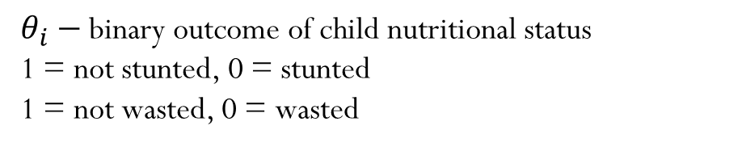
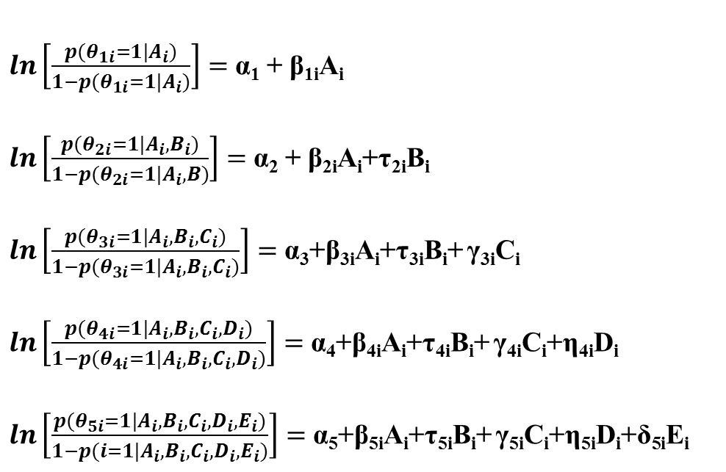

Logit Approach
$ln\left[\frac{p(θ_{1i}=1|A_{i})}{1−p(θ_{1i}=1|A_{i})}\right]=$ α₁ + β_{1i}A_{i}
$ln\left[\frac{p(θ_{2i}=1|A_{i},B_{i})}{1−p(θ_{2i}=1|A_{i},B)}\right]=$ α₂ + β_{2i}A_{i}+τ_{2i}B_{i}
$ln\left[\frac{p(θ_{3i}=1|A_{i},B_{i},C_{i})}{1−p(θ_{3i}=1|A_{i},B_{i},C_{i})}\right]=$ α₃+β_{3i}A_{i}+τ_{3i}B_{i}+ γ_{3i}C_{i}
$ln\left[\frac{p(θ_{4i}=1|A_{i},B_{i},C_{i},D_{i})}{1−p(θ_{4i}=1|A_{i},B_{i},C_{i},D_{i})}\right]=$ α₄+β_{4i}A_{i}+τ_{4i}B_{i}+ γ_{4i}C_{i}+η_{4i}D_{i}
$ln\left[\frac{p(θ_{5i}=1|A_{i},B_{i},C_{i},D_{i},E_{i})}{1−p(i=1|A_{i},B_{i},C_{i},D_{i},E_{i})}\right]=$ α₅+β_{5i}A_{i}+τ_{5i}B_{i}+ γ_{5i}C_{i}+η_{5i}D_{i}+δ_{5i}E_{i}
Odds Ratio
For binary var: $\frac{P(Y=1|θ=1)}{P(Y=0|θ=1)}$
For continuous var: $\frac{P(Y=m+1|θ=1)}{P(Y=m|θ=1)}$
$θ_{i}−$ binary outcome of child nutritional status
1 = not stunted, 0 = stunted
1 = not wasted, 0 = wasted

Slide 16
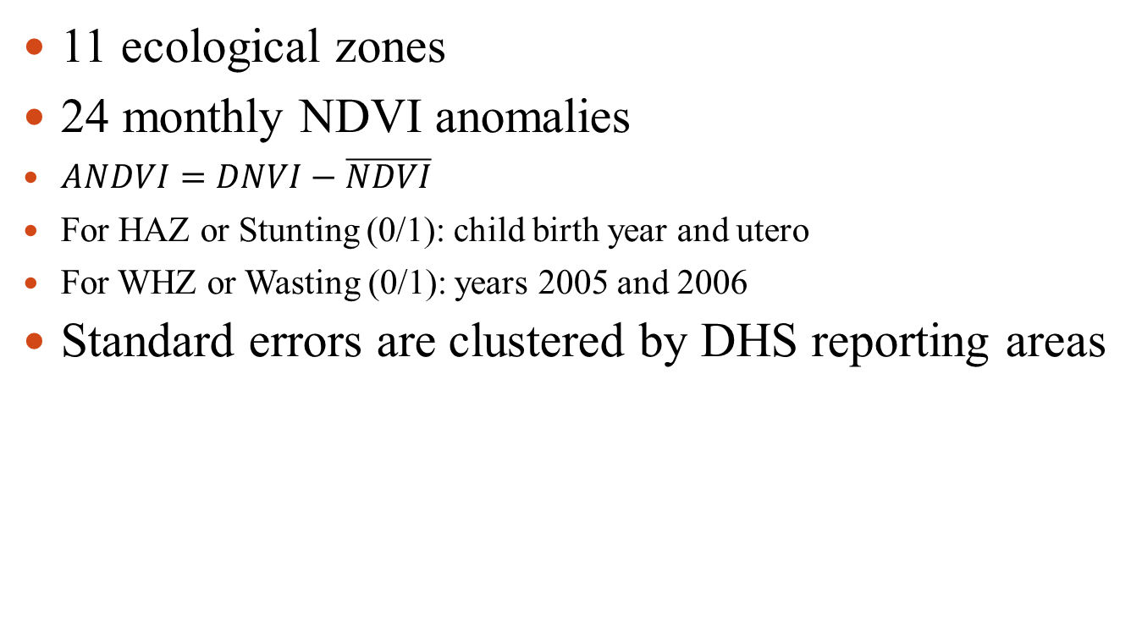
Modeling cont. Control Variables
11 ecological zones
24 monthly NDVI anomalies
$ANDVI=DNVI−\overline{NDVI}$
For HAZ or Stunting (0/1): child birth year and utero
For WHZ or Wasting (0/1): years 2005 and 2006
Standard errors are clustered by DHS reporting areas

Slide 17
Results

Slide 18
OLS Estimates for HAZ
 | variable name | child | mother | household | UNHS | NDVI
child | age | -0.016*** | -0.014*** | -0.014*** | -0.014*** | -0.014***
 | twin (1/0) | -0.828*** | -0.878** | -0.831*** | -0.802*** | -0.818***
 | anemia (1/0) | -0.416*** | -0.346*** | -0.337*** | -0.357*** | -0.357***
mother | age |  | 0.027*** | 0.021* | 0.022* | 0.022*
 | BMI |  | 0.029** | 0.020 | 0.022* | 0.021*
 | breastfeeding (1/0) |  | -0.224** | -0.203** | -0.190* | -0.191*
 | breastfeeding time |  | -0.019*** | -0.018*** | -0.017*** | -0.017***
household | wealth index score |  |  | 0.013** | 0.013** | 0.014**
 | urban/rural (1/0) |  |  | 0.040 | 0.375*** | 0.328**
 | internally displaced person (IDP) (1/0) |  |  | -0.612* | -0.455* | -0.435*
UNHS | crop yield |  |  |  | -0.034* | -0.035*
 | sales ratio |  |  |  | -0.987** | -0.965**
 | purchased inputs percentage |  |  |  | 0.689** | 0.687**
 | distance to a nearest health unit |  |  |  | 0.012*** | 0.012***
R² |  | 0.130 | 0.158 | 0.169 | 0.181 | 0.182
N |  | 2,158 | 2,158 | 2,158 | 2,158 | 2,158
Note: *p<0.10, **p<0.05, ***p<0.01. Non-significant variables excluded from table.

Slide 19
Logistic Estimates for Child Stunting
 | variable name | child | mother | household | UNHS | NDVI
child | age | 0.981*** | 0.983*** | 0.982*** | 0.981*** | 0.982***
 | twin (1/0) | 0.334*** | 0.326*** | 0.340*** | 0.368*** | 0.367***
 | anemia (1/0) | 0.613*** | 0.655*** | 0.651*** | 0.633*** | 0.631***
mother | age |  | 1.047*** | 1.040*** | 1.041*** | 1.041***
 | BMI |  | 1.061*** | 1.054*** | 1.058*** | 1.057***
 | anemia (1/0) |  | 1.159** | 1.171** | 1.193** | 1.191**
 | breastfeeding time |  | 0.984* | 0.986* | 0.986 | 0.986
 | child number |  | 0.924*** | 0.932*** | 0.926*** | 0.926***
household | wealth index score |  |  | 1.017* | 1.017* | 1.017*
UNHS | crop yield |  |  |  | 0.931*** | 0.931***
 | distance to a nearest health unit |  |  |  | 1.012*** | 1.012***
Pseudo R2 |  | 0.0751 | 0.09490 | 0.1004 | 0.1067 | 0.1067
n |  | 2.158 | 2.158 | 2.158 | 2.158 | 2.158
Note: *p<0.10, **p<0.05, ***p<0.01. Non-significant variables excluded from table.

Slide 20
OLS Estimates for WHZ
 | variable name | child | mother | household | UNHS | NDVI
child | age | 0.010*** | 0.013*** | 0.013*** | 0.013*** | 0.013***
 | twin (1/0) | -0.292** | -0.310** | -0.301** | -0.278** | -0.272**
 | bcg vaccine (1/0) | 0.309** | 0.268* | 0.269* | 0.263* | 0.261*
 | anemia (1/0) | -0.216*** | -0.147*** | -0.162*** | -0.169*** | -0.173***
mother | mother's BMI |  | 0.075*** | 0.077*** | 0.078*** | 0.078***
 | mother’s pregnancy (1/0) |  | -0.166** | -0.174** | -0.173** | -0.173**
 | breastfeeding time |  | -0.014*** | -0.013*** | -0.013*** | -0.013***
household | altitude |  |  | -0.02 | -0.021* | -0.025*
UNHS | distance to a nearest health unit |  |  |  | 0.004* | 0.005*
NDVI | ndvi06harv |  |  |  |  | 0.002*
R² |  | 0.077 | 0.123 | 0.126 | 0.128 | 0.130
N |  | 2,158 | 2,158 | 2,158 | 2,158 | 2,158
Note: *p<0.10, **p<0.05, ***p<0.01. Non-significant variables excluded from table.

Slide 21
Logistic Estimates for Child Wasting
 | variable | child | mother | household | UNHS | NDVI
child | age | 1.052*** | 1.060*** | 1.059*** | 1.059*** | 1.059***
 | sex (1/0) | 0.793** | 0.743*** | 0.769** | 0.773** | 0.772**
 | twin (1/0) | 0.235*** | 0.206*** | 0.222*** | 0.251*** | 0.262**
 | bcg vaccine (1/0) | 2.146* | 2.076 | 2.167 | 2.090 | 2.090
 | anemia (1/0) | 0.711* | 0.835 | 0.822 | 0.830 | 0.829
mother | BMI |  | 1.158*** | 1.180*** | 1.185*** | 1.185***
 | breastfeeding time |  | 0.963** | 0.966** | 0.965** | 0.966**
household | age of head of household |  |  | 0.981* | 0.980* | 0.980*
 | number of eligible working people |  |  | 0.826*** | 0.837*** | 0.835***
Pseudo R2 |  | 0.1358 | 0.1602 | 0.1768 | 0.1808 | 0.1814
n |  | 2,158 | 2,158 | 2,158 | 2,158 | 2,158
Note: *p<0.10, **p<0.05, ***p<0.01. Non-significant variables excluded from table.

Slide 22
OLS Estimates among Sub-groups
 |  | rural, non-IDP camps |  | urban only |  | IDP camps only
 | variable | HAZ | WHZ | HAZ | WHZ | HAZ | WHZ
child | age | -0.014*** | 0.014*** | -0.012** | 0.001 | -0.003 | 0.013**
 | twin (1/0) | -1.059*** | -0.177*
 | anemia (1/0) | -0.395*** | -0.196***
mother | age | 0.021* | -0.002 |  |  | 0.024 | -0.007
 | education | -0.007 | -0.001 | 0.040* | 0.018 | -0.055 | -0.023
 | BMI | 0.016 | 0.076*** | 0.016 | 0.067*** | 0.089* | 0.156***
 | pregnancy (1/0) | -0.164 | -0.177**
 | breastfeeding time | -0.016*** | -0.011*** | -0.01 | -0.026*** | -0.049*** | -0.029**
household | wealth | 0.012* | -0.001 | 0.040*** | -0.018* | -0.005 | 0.053*
 | dependency | -0.095* | -0.016 | 0.122 | -0.329*** | 0.164* | 0.011
 | safe water (1/0) | 0.228 | -0.147 | -0.275* | -0.279 | 0.547* | 0.116
 | TLU | 0.035** | 0.002 | -0.026* | 0.015
 | altitude | -0.006 | -0.040* | 0.011 | 0.003 | -0.032 | 0.191
UNHS | crop yield | -0.031 | -0.016* | -0.075* | 0.064
 | disthealth | 0.011*** | 0.005
NDVI | ndvi05harv |  | 0.002**
 | ndvi06harv |  | -0.002**
n |  | 1733 | 1733 | 204 | 204 | 221 | 221
Note: *p<0.10, **p<0.05, ***p<0.01. Non-significant variables excluded from table.

Slide 23
Logistic Estimates among Sub-groups
 |  | rural, non-IDP camps |  | urban only |  | IDP camps only
 | variable name | HAZ | WHZ | HAZ | WHZ | HAZ | WHZ
child | age | 0.981*** | 1.066*** | 0.995 | 1.026 | 0.995 | 1.068*
 | twin (1/0) | 0.297*** | 0.315**
 | anemia (1/0) | 0.671*** | 0.854
mother | age | 1.038*** | 1.038 |  |  | 1.037 | 0.982
 | BMI | 1.045*** | 1.235*** | 1.059* | 1.057 | 1.127 | 1.163
 | anemia (1/0) | 1.166* | 1.132
 | pregnancy (1/0) | -0.164 | -0.177**
 | breastfeeding time | 0.988 | 0.968 | 1.009 | 0.926 | 0.932*** | 0.957
 | child number | 0.908*** | 0.925
household | dad work | 1.318 | 0.640 | 0.443*** | 0.267 | 0.823 | 0.641
 | hoh age | 1.007 | 0.976* |  |  | 1.023** | 1.020
 | hoh sex (1/0) | 1.066 | 0.883 | 0.406*** | 1.385 | 1.540 | 2.064
 | wealth | 1.023** | 1.016 | 1.027 | 0.968 | 0.968 | 1.148
 | dependency | 0.961 | 1.017 | 0.963 | 0.345*** | 0.935 | 0.714
UNHS | crop yield | 0.940** | 0.987 | 0.858** | 1.129
 | sales ratio | 0.505 | 0.992 | 0.041** | 0.087
 | disthealth | 1.013*** | 1.029
NDVI | ndvi05harv |  | 0.002**
n |  |  | 1733 | 1733 | 204 | 204 | 221
Note: *p<0.10, **p<0.05, ***p<0.01. Non-significant variables excluded from table.

Slide 24
Conclusions and Further Research

Slide 25
Conclusions
Child and mother characteristics play the most important role in child growth in Uganda
Agricultural variables nested at the district level have only limited explanatory power
Average NDVI values corresponding to recently preceding harvest months are positively correlated with a short-term measure of child wasting (WHZ)
Factors associated with child malnutrition appear to differ across sub-regions

Slide 26
Limitations and Further Research
Children in the same nesting with different nutritional status are tagged with the same UNHS information
NDVI values in general are found to be of limited use in explaining child Z-scores
This research uses data from DHS and UNHS in 2006, surveys for other years could be analyzed.

Slide 27
Questions?

